Slide 1
Naming Variables in R
The DARTH workgroup
December 2022

Slide 2

Resources for today’s talk
DARTH-git/darthpack: A decision-analytic modeling coding framework (github.com)

Slide 3

Overview
Model structure
File structure
Variable structure
Code structure
Darthpack Package

Slide 4
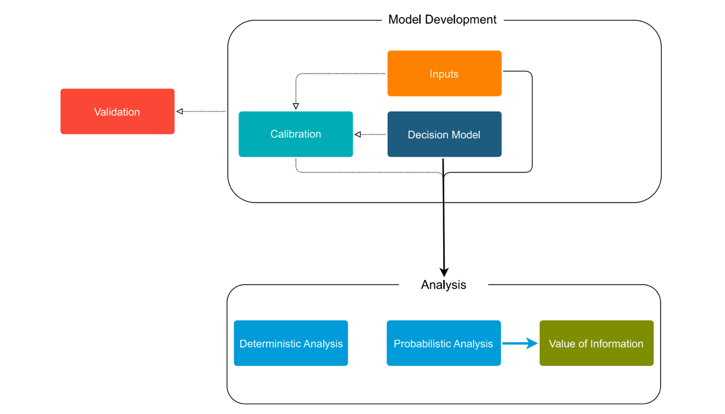
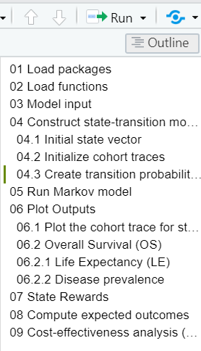
Model Structure

Slide 5

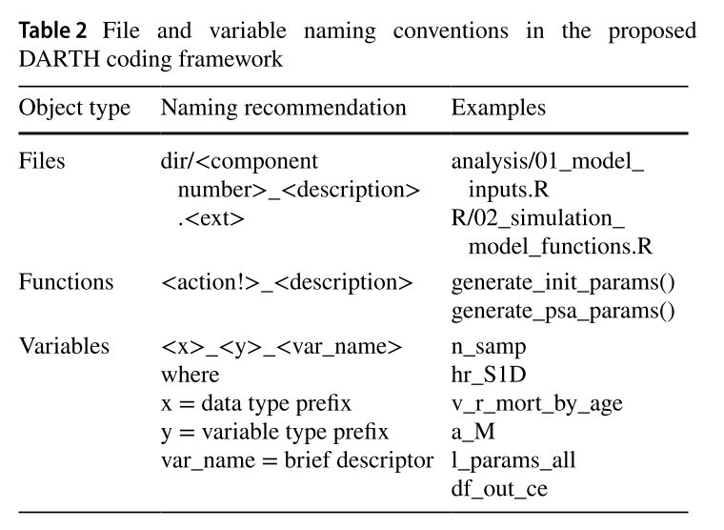
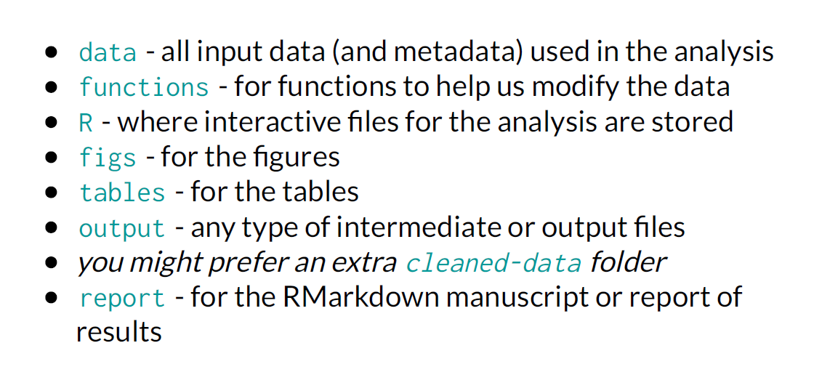
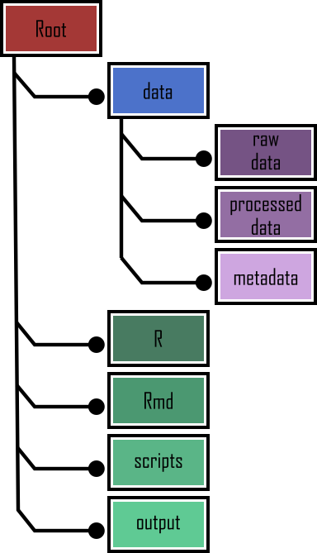
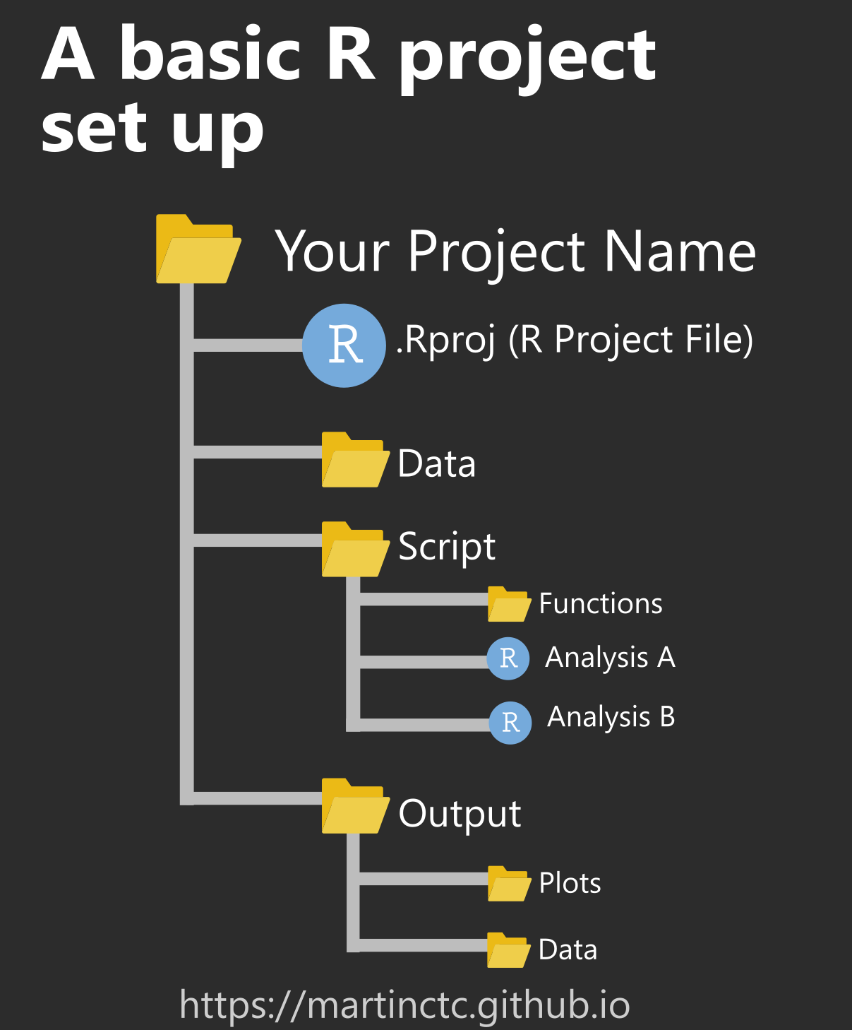
Files structure
R Project

Slide 6
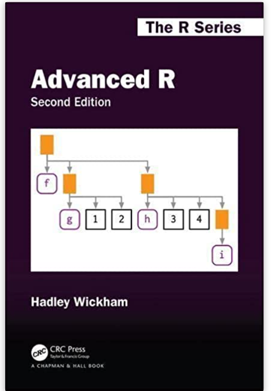
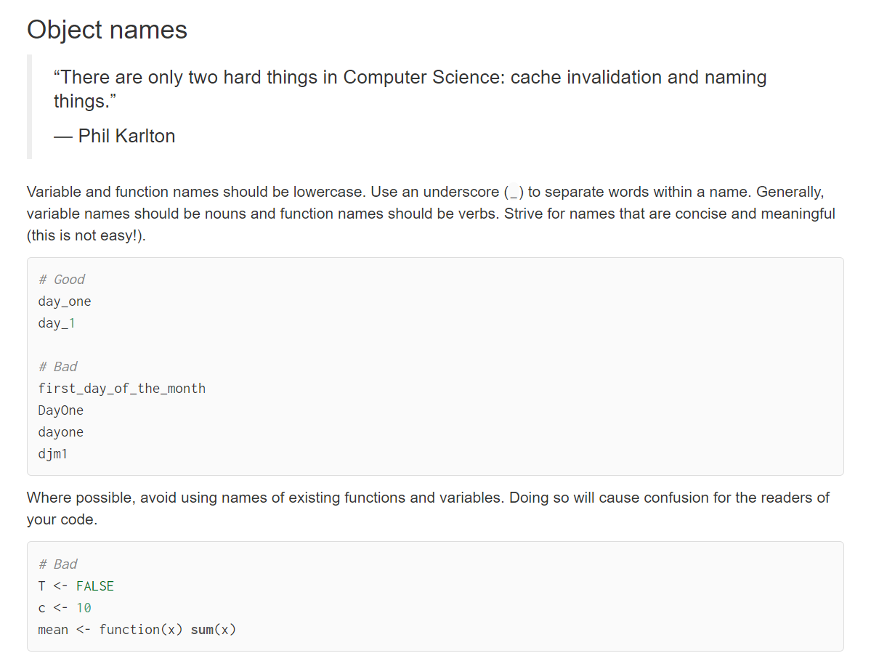
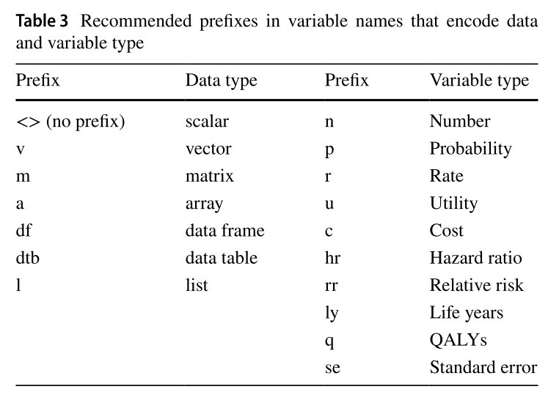
Variable names structure

Slide 7
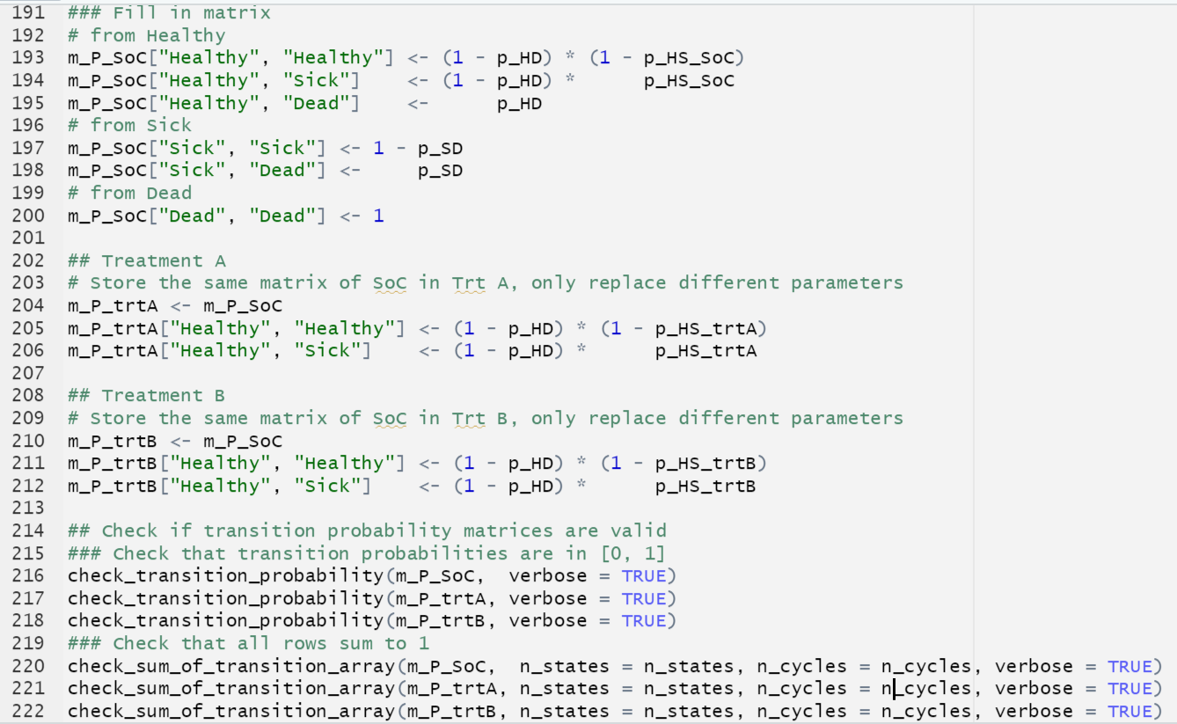
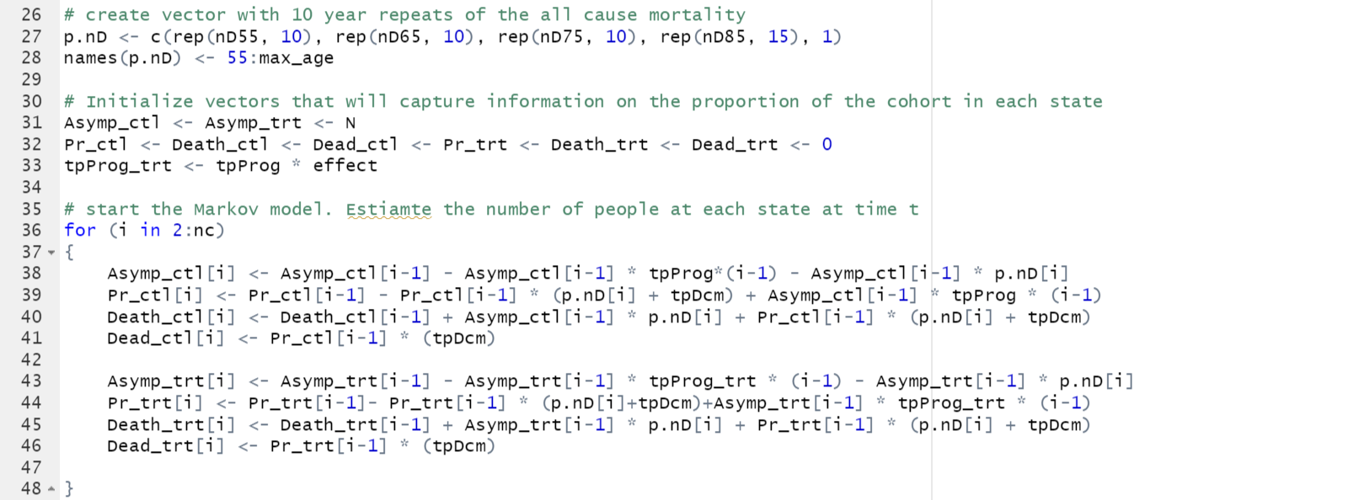
Code structure - and beauty ☺
R Package styler

Slide 8
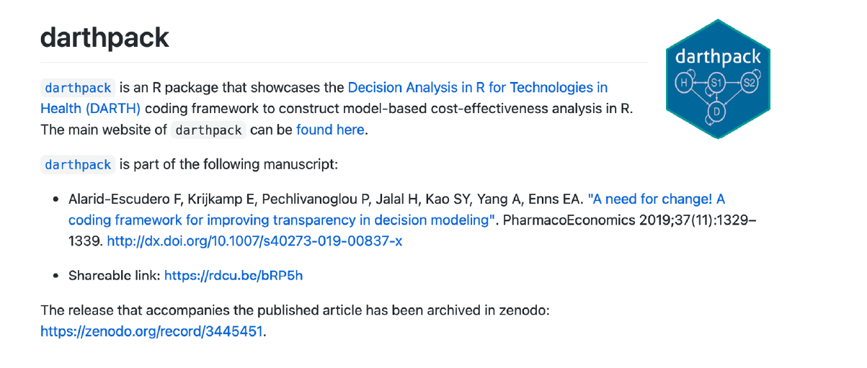
Darthpack R Package

